Slide 1

UNIVERSITY INSTITUTE OF ENGINEERING
COMPUTER SCIENCE ENGINEERING
Bachelor of Engineering (Computer Science & Engineering)
Subject Name: Internet of Things
Subject Code: 20CST-357
Issues raised by IoT
DISCOVER . LEARN . EMPOWER

Slide 2
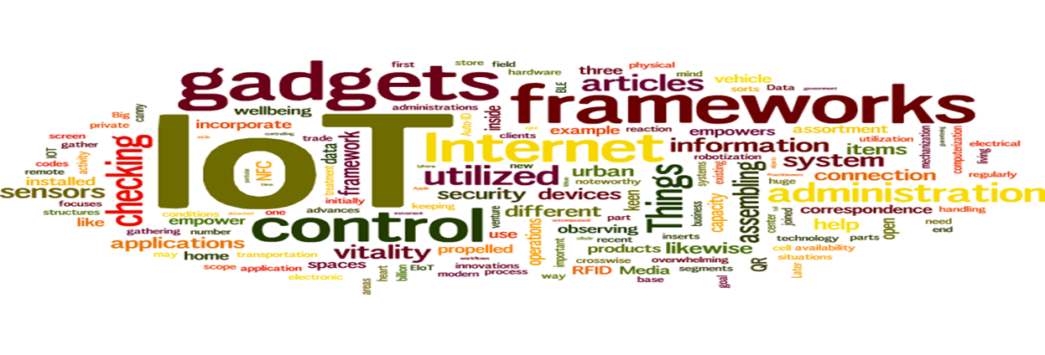
Internet of Things
Course Outcomes:
1. Analyze the basic terminologies associated with IoT and use it.
2. Justify the applications of internet of things and correlate them.
3. Compare different objects and communication strategies and also able to see the issues raised by communication strategies in IoT.
4. Examine the protocols required for communication and packet size required for each application.
5. Illustrate security issues with IoT like security, privacy, communication standard and some other legal issues.

Slide 3
UNIT 2 CHAPTER 4 Issues raised by Internet of Things

Slide 4
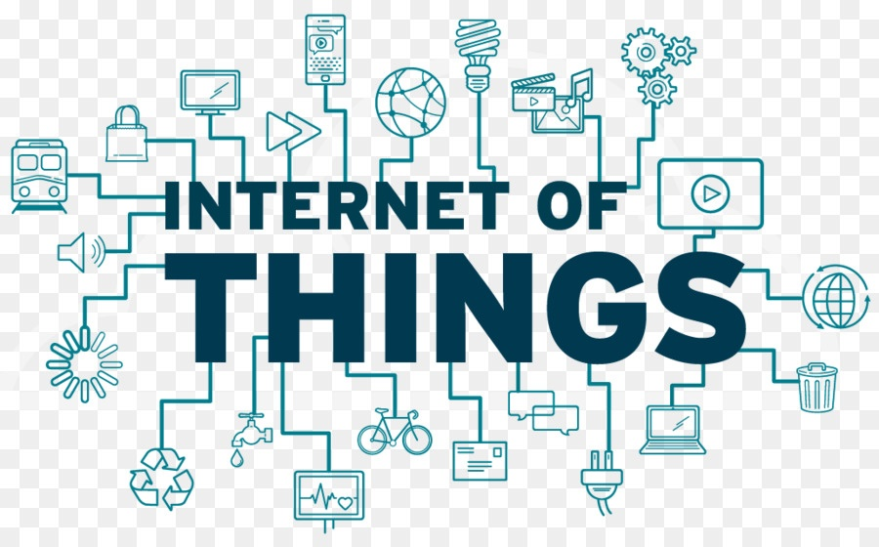
Internet of Things
Security Issues
The IoT Security Challenge
A Spectrum of Security Considerations
Unique Security Challenges of IoT Devices and Privacy
Considerations: IoT Privacy Background
Unique Privacy Aspects of Internet of Things
Interoperability

Slide 5
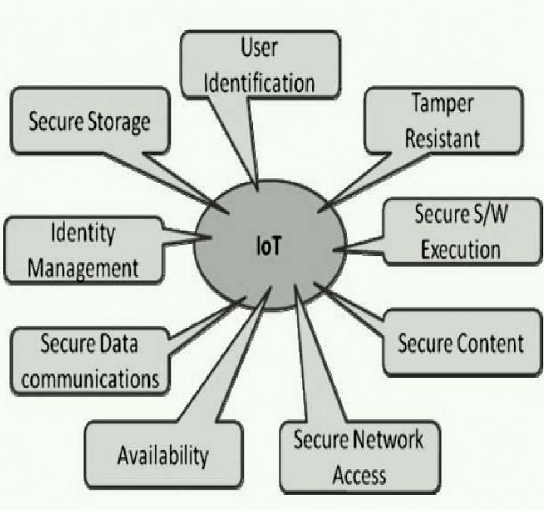
Security Issues related with IoT (CO-5)

Slide 6
What are the security issues in the IoT? (CO-5)
While IoT devices play a huge role in the discussion of IoT security, placing all the focus on this aspect of the IoT does not provide a full picture of why security is necessary and what it entails.
There are many factors that make IoT security critical today.
Threats and risks
IoT security is critical largely because of the expanded attack surface of threats that have already been plaguing networks. Adding to these threats are insecure practices among users and organizations who may not have the resources or the knowledge to best protect their IoT ecosystems.
These security issues include the following:
1. Vulnerabilities.
2. Malware.
3. Escalated cyber attacks.
4. Information theft and unknown exposure.
5. Device mismanagement and misconfiguration.

Slide 7
Emerging Issues in IoT
The lack of industry foresight gave little time to develop strategies and defenses against familiar threats in growing IoT ecosystems. Anticipating emerging issues is one of the reasons research on IoT security must be done continuously. Here are some of the emerging issues that need to be monitored:
Complex environments
2. Prevalence of remote work arrangements.
3. 5G connectivity.

Slide 8
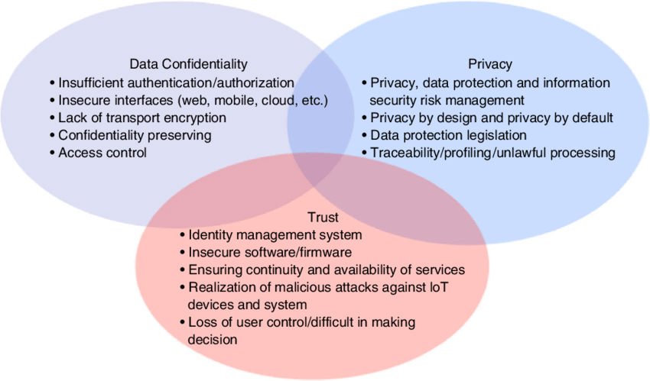

Slide 9
How to secure the IoT (CO-5)
There is no instant fix that can answer the security issues and threats laid out in this article. Specific strategies and tools may be necessary for properly securing more specialized systems and aspects of the IoT. However, users can apply a few best practices to reduce risks and prevent threats:
1. Assign an administrator of things
2. Regularly check for patches and updates
3. Use strong and unique passwords for all accounts.
4. Prioritize Wi-Fi security
5. Monitor baseline network and device behavior.
6. Apply network segmentation.
7. Secure the network and use it to strengthen security
8. Secure IoT-cloud convergence and apply cloud-based solutions
9. Consider security solutions and tools.
10. Take into consideration the different protocols used by IoT devices.
11. Secure the heavy use of GPS.

Slide 10
The IoT Security Challenge (CO-5)
Top ten challenges for IoT security are as follows:
Secure constrained devices
Authorize and authenticate devices
Manage device updates
Secure communication
Ensure data privacy and integrity
Secure web, mobile, and cloud applications
Ensure high availability
Prevent incidents by detecting vulnerabilities
Manage vulnerabilities
Predict and preempt security issues

Slide 11
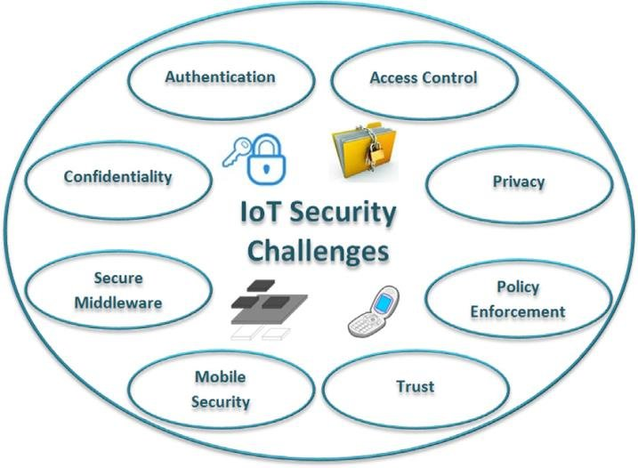

Slide 12
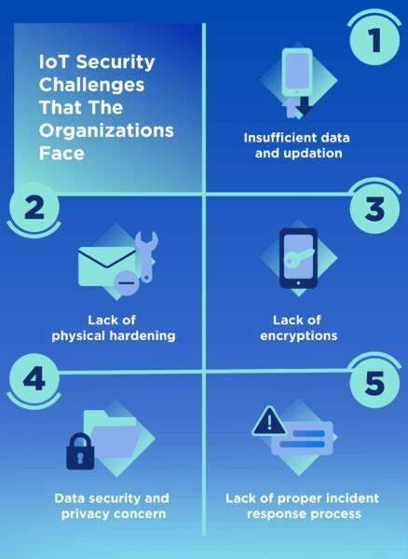

Slide 13
Addressing IoT Security Challenges (CO-5)
A holistic approach is required to implement and manage IoT security effectively. It must encompass a variety of tactics and tools as well as take into consideration adjacent systems, such as networks.
Three key capabilities for a robust IoT security solution are the ability to:
1. Learn
Take advantage of security solutions that provide network visibility to learn what the ecosystem encompasses at what the risk profiles are for each group of IoT devices.
2. Protect
Monitor, inspect, and enforce IoT security policies commiserate with activities at different points in the infrastructure
3. Segment
In the same way that networks are segmented, use segmentation based on policy groups and risk profiles to segment IoT systems.

Slide 14
Specific features required for securing IoT devices include the following:
API security
Broader and deep IoT device inventory
Continuous software updates
DNS filtering
Education and training staff, vendors, and partners
Encryption for data at rest and in transit
Honeypot decoy programs
Multi-factor authentication
Network security
Network traffic monitoring analysis
Password management
Patch management
Security gateways
Unauthorized IoT device scans

Slide 15
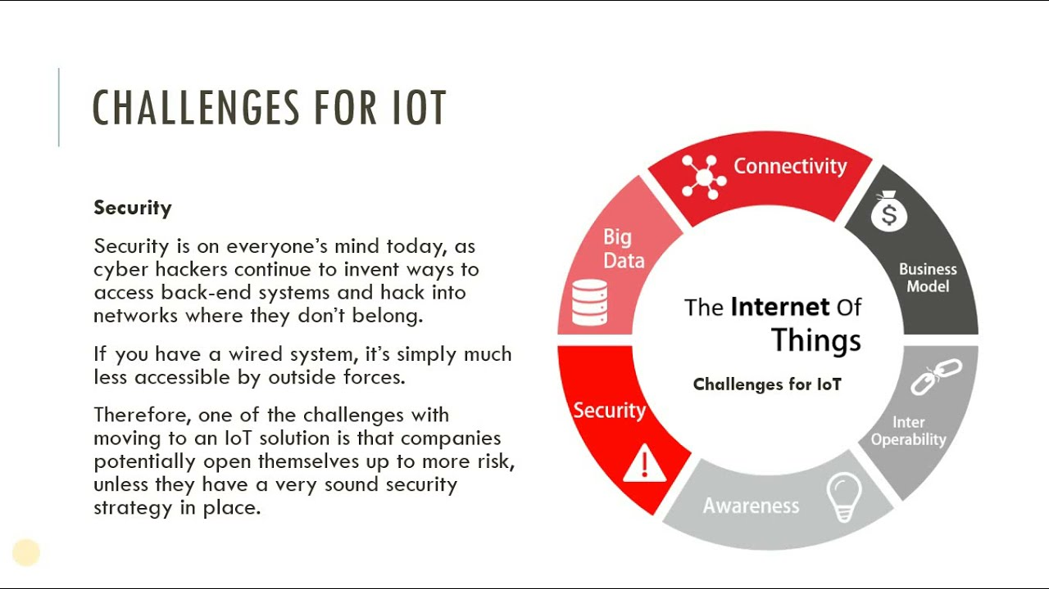

Slide 16
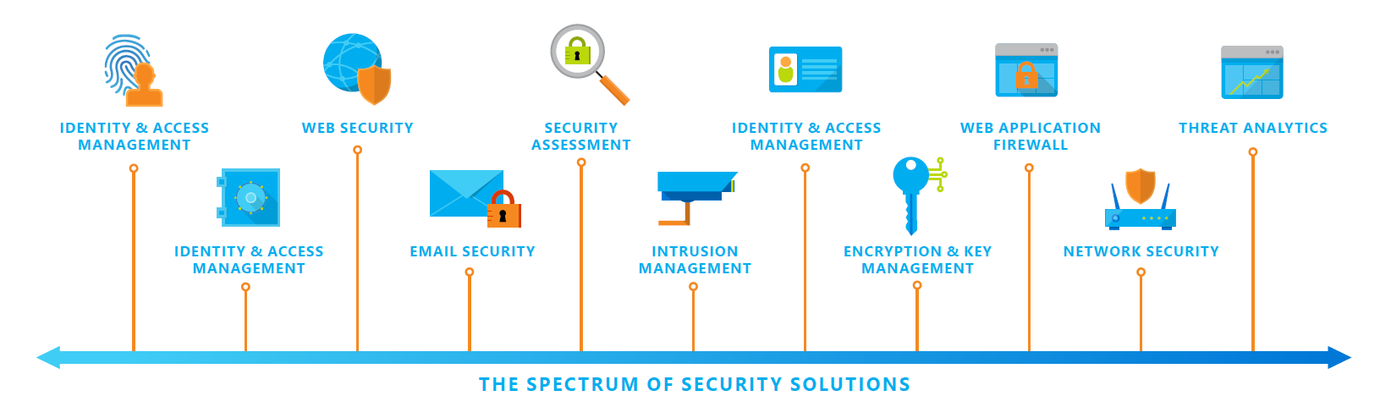
A SPECTRUM OF SECURITY CONSIDERATIONS (CO-5)

Slide 17
5 Ways to Secure IoT in any Enterprise:
Employ device discovery for visibility across the board
Actively Monitor IoT Devices
3. Carefully configure your router
4. Adopt Secure Password Practices
5. Keep an eye on vendor & supplier IoT practices

Slide 18
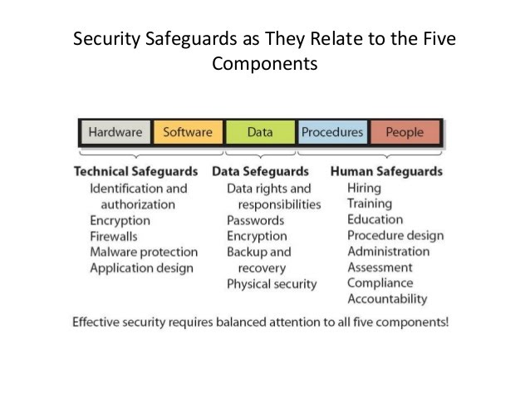

Slide 19
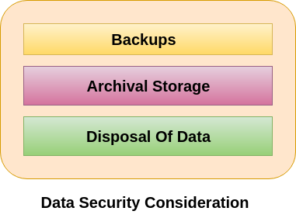
To use the Backup 3-2-1 Rule is very popular. This rule includes:
1. Three copies of our data
2. Two different formats, i.e., hard drive + tape backup or DVD (short term)+flash drive
3. One off-site backup, i.e., have two physical backups and one in the cloud
Some important backup options are as follows:
1. Hard drives - personal or work computer
2. Departmental or institution server
3. External hard drives
4. Tape backups
5. Discipline-specific repositories
6. University Archives
7. Cloud storage

Slide 20
Some of the top considerations for implementing secure backup and recovery are-
Authentication of the users and backup clients to the backup server.
Role-based access control lists for all backup and recovery operations.
Data encryption options for both transmission and the storage.
Flexibility in choosing encryption and authentication algorithms.
Backup of a remote client to the centralized location behind firewalls.
Backup and recovery of a client running Security-Enhanced Linux (SELinux).
Using best practices to write secure software.

Slide 21
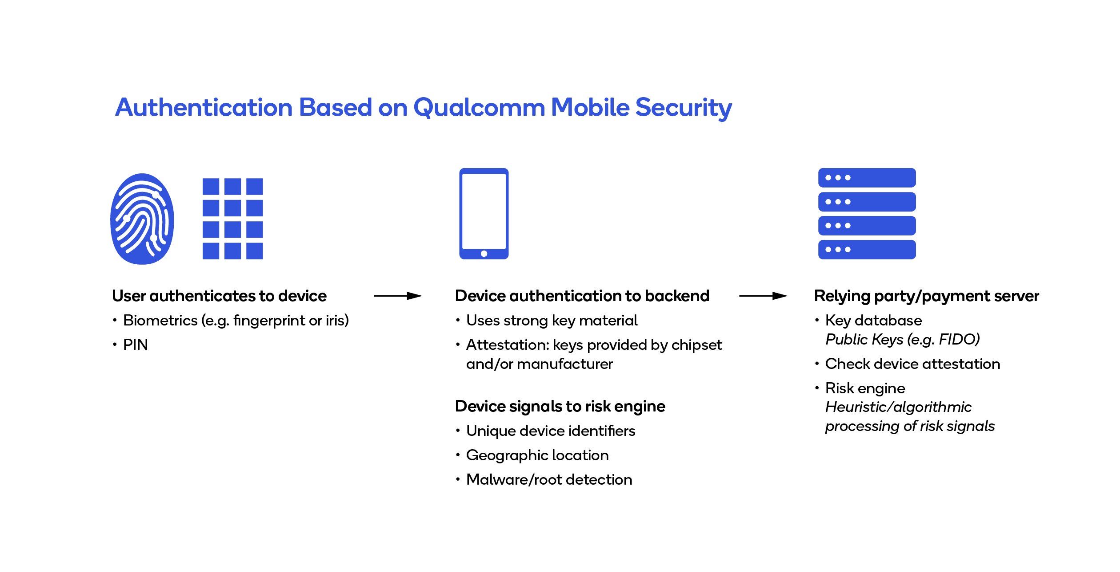

Slide 22
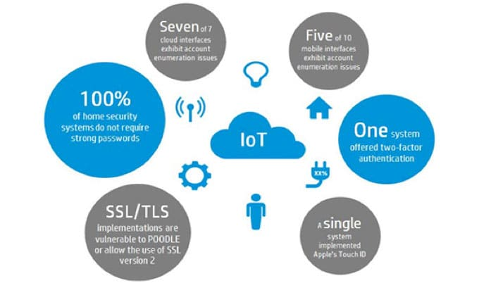
Unique Security Challenges of IoT Devices and Privacy (CO-5)

Slide 23
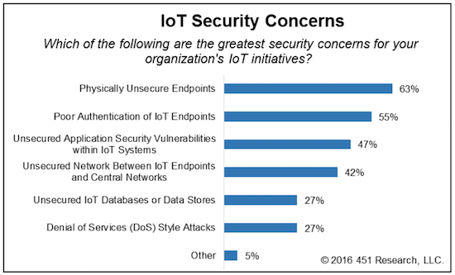

Slide 24
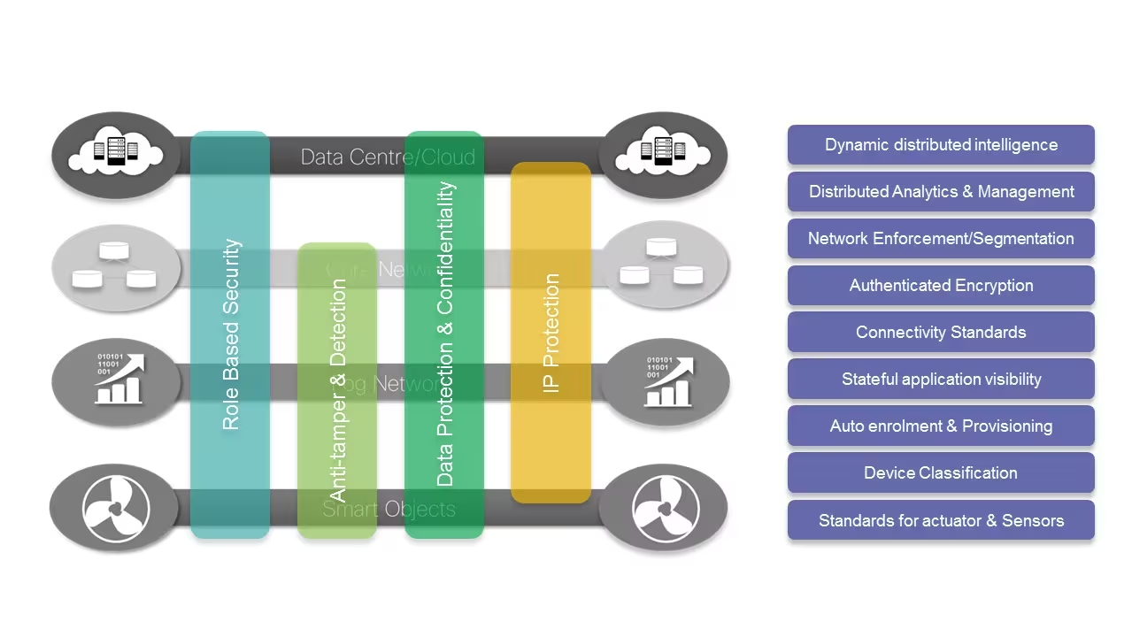

Slide 25
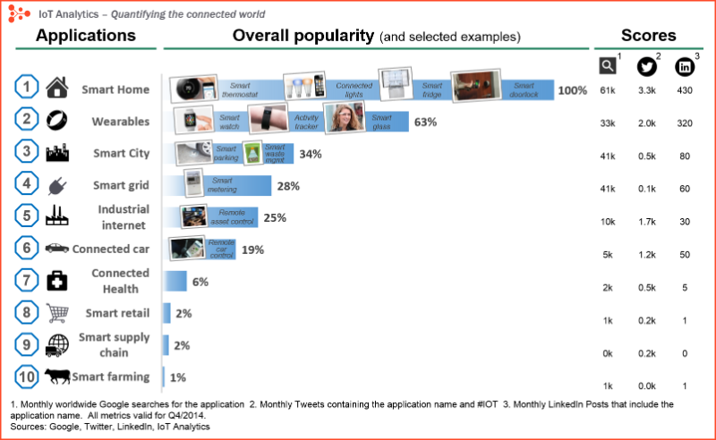

Slide 26
Privacy Policy (CO-5)
Site Visit data
UIDAI Website does not automatically capture any specific personal information from you, (like name, phone number or e-mail address), that allows us to identify you individually.
This website records your visit and logs the following information for statistical purposes, such as Internet protocol (IP) addresses, domain name, server's address; name of the top-level domain from which you access the Internet (for example, .gov, .com, .in, etc.), browser type, operating system, the date and time of the visit, the pages you have accessed, the documents downloaded and the previous Internet address from which you linked directly to the site. We make no attempt to link these addresses with the identity of individuals visiting our site unless an attempt to damage the site has been detected. We will not identify users or their browsing activities, except when a law enforcement agency may exercise a warrant to inspect the service provider's logs.
If the UIDAI Website requests you to provide personal information, you will be informed for the particular purposes for which the information is gathered and adequate security measures will be taken to protect your personal information. UIDAI does not sell or share any personally identifiable information volunteered on the UIDAI Website to any third party (public/private). Any information provided to this website will be protected from loss, misuse, unauthorized access or disclosure, alteration, or destruction.

Slide 27
3. Cookies
A cookie is a piece of software code that an Internet website sends to your browser when you access information in that site. This site does not use cookies.
4. E-mail Management
Your e-mail address will only be recorded if you choose to send a message. It will only be used for the purpose for which you have provided it and will not be added to a mailing list. Your e-mail address will not be used for any other purpose, and will not be disclosed without your consent.

Slide 28
5. Collection of Personal Information
If you are asked for any other Personal Information you will be informed how it will be used if you choose to give it. If at any time you believe the principles referred to in this privacy statement have not been followed, or have any other comments on these principles, please notify the Web Information Manager by sending email to webadmin[-]uidai[@]nic[.]in.
Note: The use of the term "Personal Information" in this privacy statement refers to any information from which your identity is apparent or can be reasonably ascertained.
6. Reasonable Security Practices
Reasonable security measures such as administrative, technical, operational and physical controls have been implemented to ensure the security of personal information, if collected.

Slide 29
Considerations: IoT Privacy Background (CO-5)
IoT privacy refers to the issue where the manufacturer of the device has the ability to monitor and to use the data that they get from these devices. As the user connects more and more devices to the system, it increases the threat surface of the system. The ability to limit privacy is necessary to establish trust with an IoT system device.
Is the Internet of Things Secure?
In a world where we already face numerous security and privacy risks, IoT creates even more exposure.
Most privacy issues related to the Internet of Things come from the internet-connected devices we use every day. And whenever these devices connect, they deliver an amazing amount of sensitive information to third parties.
And more often than not, these transfers aren’t secure or obvious to the user.
With more businesses and individuals connecting critical devices and systems, Internet of Things privacy is a bigger issue than ever.
And while sending data isn’t always risky, collecting and analyzing info from multiple locations can often reveal sensitive information.

Slide 30
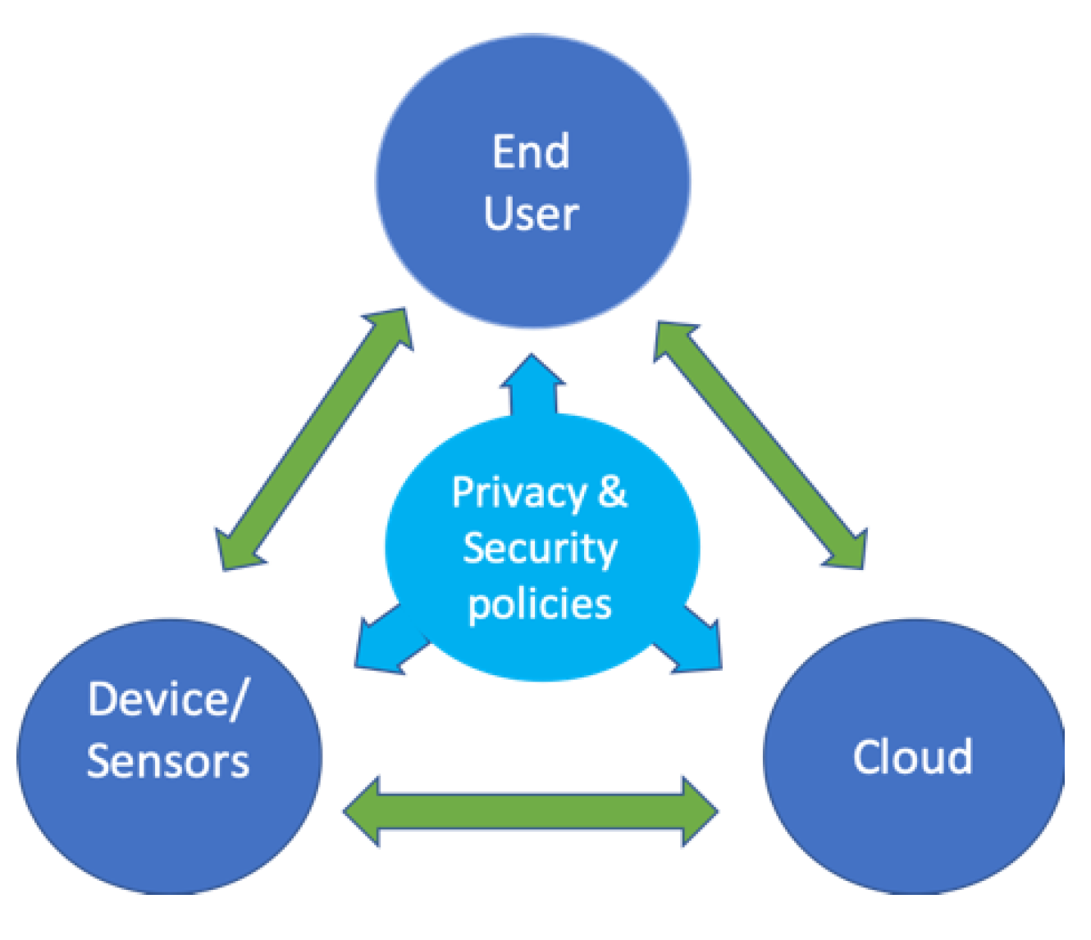

Slide 31
What are Two Privacy Issues Regarding the Internet of Things? (CO-5)
1. Data Overload
The amount of data IoT devices generate is staggering. Studies show that 10,000 households can create 150 million distinct data points every day. This risks not only your own information but details about your family, daily habits, changes in routine and more.
2. Spying
The more internet-enabled devices we use, the more open we are to online threats. When these devices are connected, an attack on any one of them opens the door to all of them, providing access to all kinds of personal information.
For example, say you want to keep an eye on your devices. In that case, all the Internet-enabled devices that make communication easy should be accounted for. This includes all sensors, light bulbs, video cameras, Wi-Fi routers, and more. Attackers could exploit weaknesses and password recovery processes to gain access to your system.

Slide 32
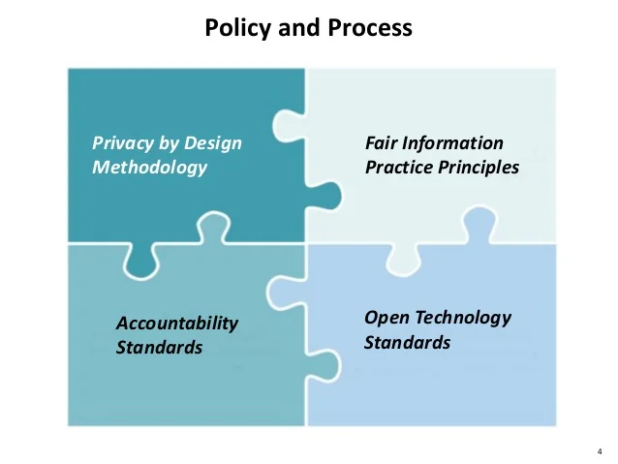

Slide 33
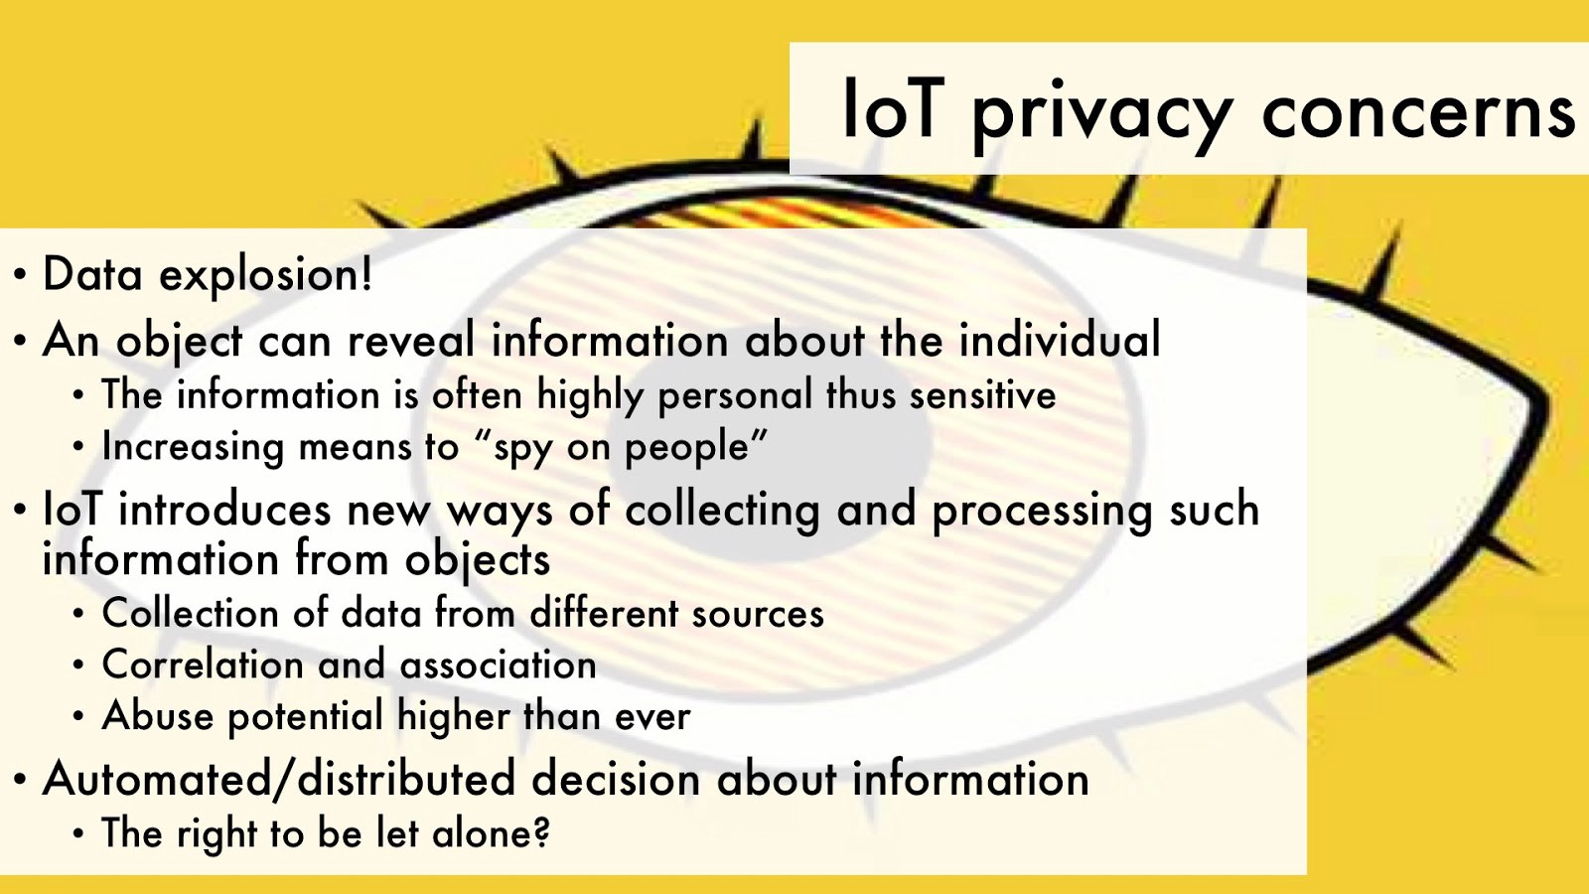

Slide 34
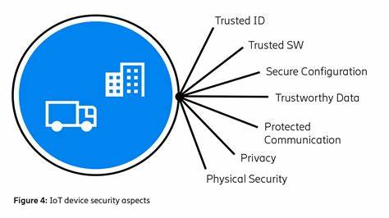
Unique Privacy Aspects of IoT (CO-5)

Slide 35
Privacy Concerns in IoT
While the challenges to security are quite prevalent in IoT, the concerns of privacy are also another critical factor. Many people also want to find out ‘What are the privacy concerns in IoT?’ and the answers could help in improving IoT for large-scale adoption. Let us take a look at some of the common privacy concerns in IoT which you can find today.
1. Abundance of Data
2. Eavesdropping
3. Unwanted Public Exposure

Slide 36
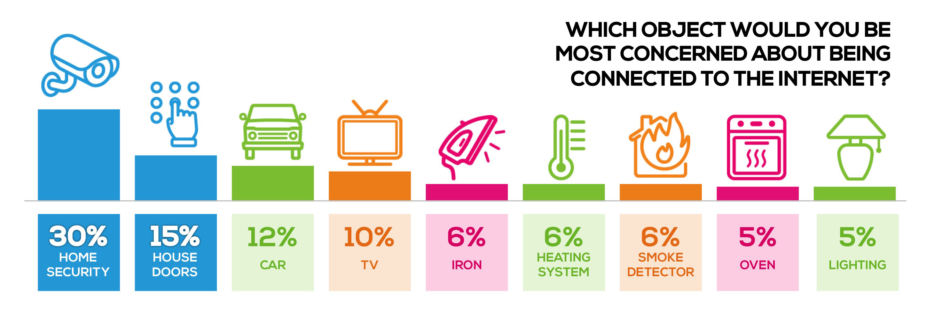

Slide 37
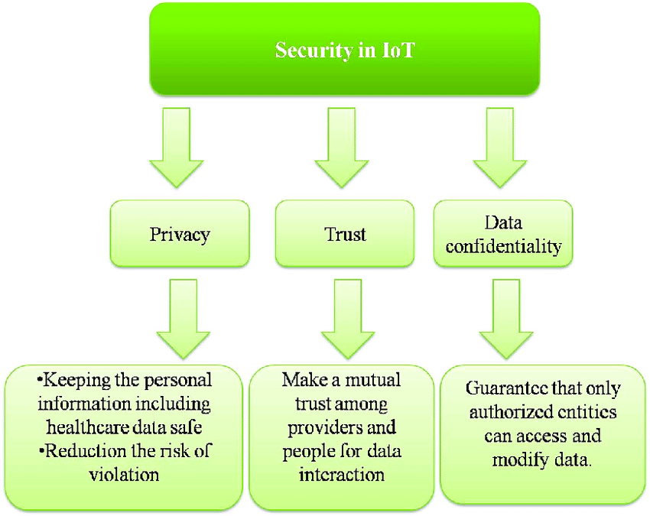

Slide 38
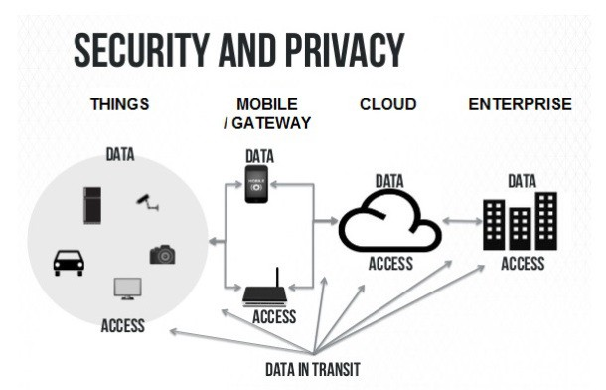

Slide 39
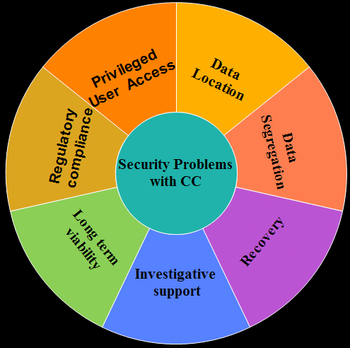

Slide 40
INTEROPERABILITY (CO-3)
The urgency in the requirement for interoperability and interoperable solutions in IoT arose mainly due to the following reasons:
Large-scale Cooperation: There is a need for cooperation and coordination among the huge number of IoT devices, systems, standards, and platforms; this is a long-standing problem
(ii) Global Heterogeneity: The network of devices within and outside the purview of gateways and their subnets are quite large considering the spread of IoT and the applications it is being adapted to daily.
(iii) Unknown IoT Device Configuration: Device heterogeneity is often accompanied by further heterogeneity in device configurations.
(iv) Semantic Conflicts: The variations in processing logic and the way data is handled by the numerous sensors and devices making up a typical IoT implementation, makes it impossible for rapid and robust deployment.

Slide 41
Internet of Things (IoT) is an ever-growing network of physical devices embedded with sensors, actuators and wire-less connectivity to communicate and share their information among themselves. The application of IoT is in diverse areas such as agriculture, poultry and farming, smart city, and health care, where a sensor node must support heterogeneous sensors/actuators, and varying types of wireless connectivity. Interoperability is the ability of two or more devices, systems, platforms or networks to work in conjunction. Interoperability enables communication between heterogeneous devices or system in order to achieve a common goal. However, the current devices and systems are fragmented with respect to the communication technologies, protocols, and data formats. This diversity makes it difficult for devices and systems in the IoT network to communicate and share their data with one another. The utility of IoT network is limited by the lack of interoperability.

Slide 42
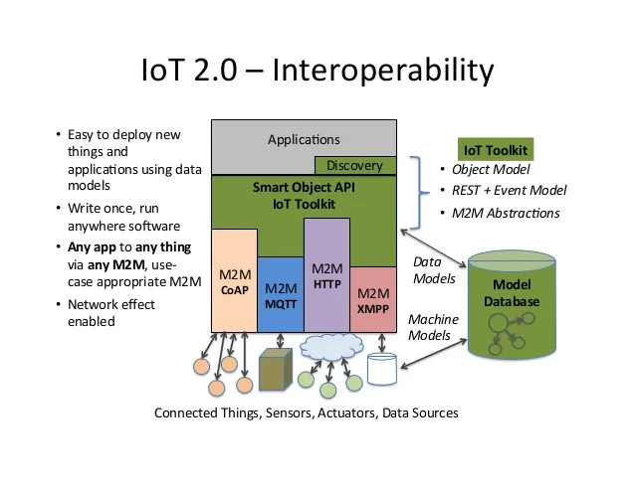

Slide 43
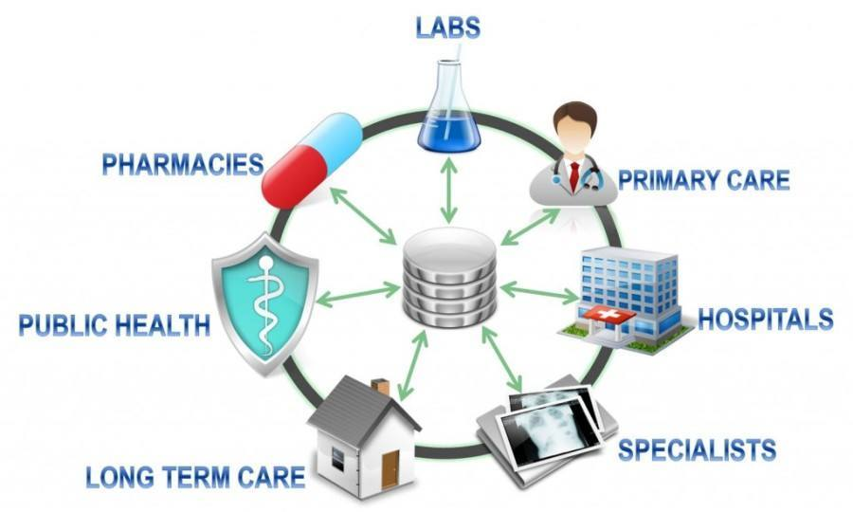

Slide 44
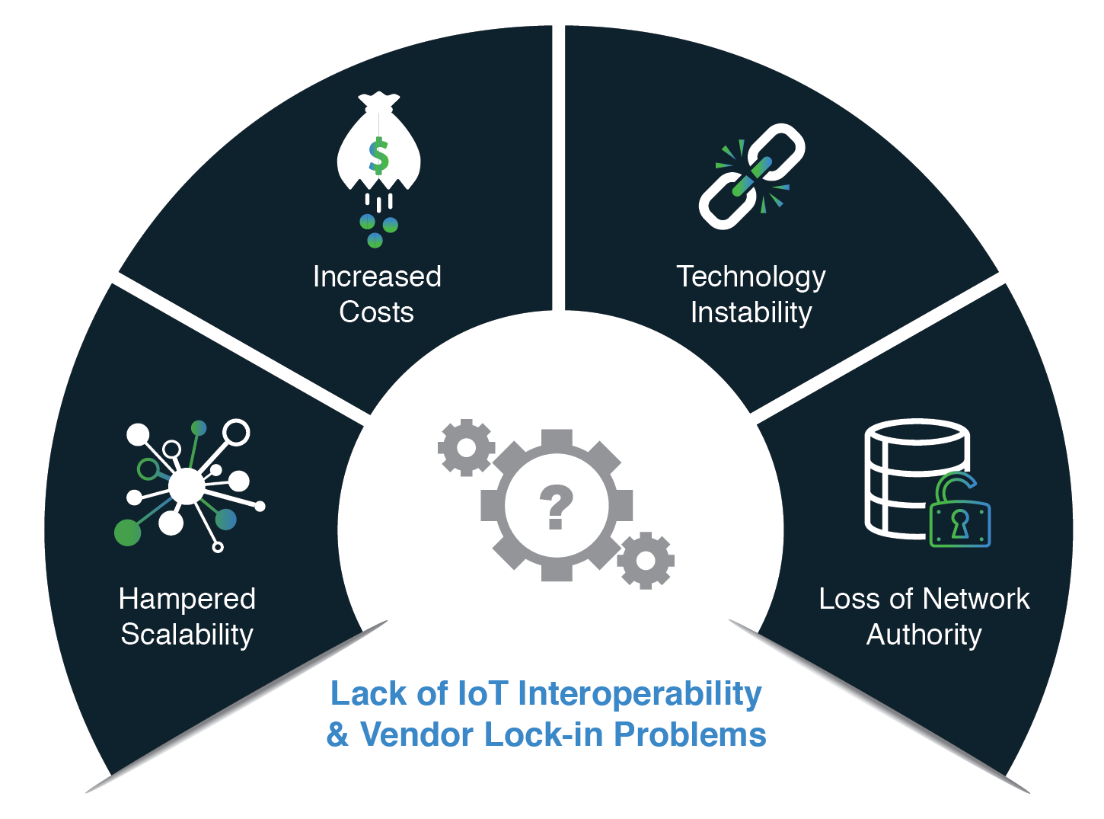

Slide 45
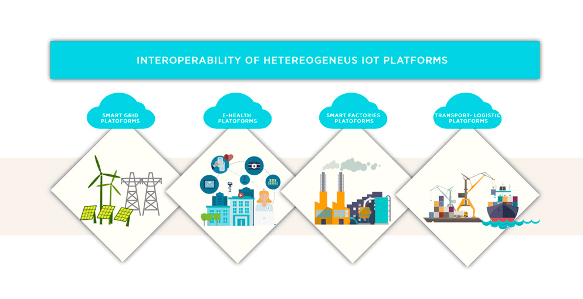

Slide 46
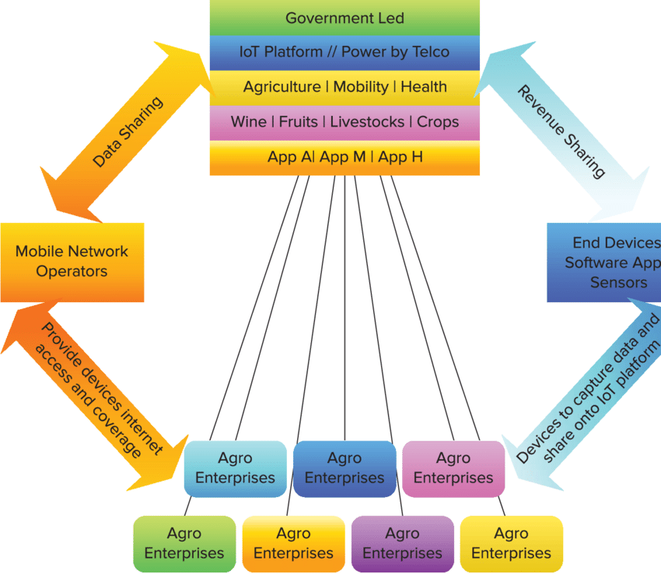

Slide 47
Summary
The Internet of Things holds significant promise for delivering social and economic benefits to emerging and developing economies. This includes areas such as sustainable agriculture, water quality and use, healthcare, industrialization, and environmental management, among others. As such, IoT holds promise as a tool in achieving the United Nations Sustainable Development Goals.
The broad scope of IoT challenges will not be unique to industrialized countries. Developing regions also will need to respond to realize the potential benefits of IoT. In addition, the unique needs and challenges of implementation in less-developed regions will need to be addressed, including infrastructure readiness, market and investment incentives, technical skill requirements, and policy resources.
The Internet of Things is happening now. It promises to offer a revolutionary, fully connected “smart” world as the relationships between objects, their environment, and people become more tightly intertwined. Yet the issues and challenges associated with IoT need to be considered and addressed in order for the potential benefits for individuals, society, and the economy to be realized.

Slide 48
Quiz
1. Interoperability is best defined as:
a. The exchange of the latest news information.
b. The ability of systems to work together in order to communicate and exchange information when necessary.
c. The development of the latest weather story.
d. All of the responses are correct.
2. Which Internet of Things (IoT) challenge involves the difficulty of developing and implementing protocols that allow devices to communicate in a standard fashion?
a. Security b. Privacy
c. Interoperability d. Compliance
3. Which one of the following is NOT an example of store-and-forward messaging?
Voicemail b. Unified messaging
c. Telephone call d .Email
4. Which action is the best step to protect Internet of Things (IoT) devices from becoming the entry point for security vulnerabilities into a network while still meeting business requirements?
a. Turning IoT devices off when not in use b.Removing IoT devices from the network
c. Using encryption for communications d.Applying security updates promptly.

Slide 49
5. What do organizations need to expect as they get more dependent upon the Internet of Things (IoT)?
Security risks will increase. b. Security risks will go down.
c. Security risks will stay the same. d. Security risks will be eliminated.
6. How many numbers of the element in the open IoT architecture?
a. Four elements b. Five elements
c. Six elements d. Seven elements
7. Which of the following is the way in which an IoT device is associated with data?
a. Internet b. Cloud
c. Automata d. Network
8. Which of the following IoT networks has a very short range?
a. Short Network b. LPWAN
c. SigFox d. Short range wireless network
9. An IoT network is a collection of ______ devices.
a. Signal b. Machine to Machine
c. Interconnected d. Network to Network
10. Which one of the following is not an IoT device?
a. Amazon echo voice controller b. Google Home
c. Nest Smoke Alarm d. None of these

Slide 50
REFERENCES
Text Books:
Ovidiu Vermesan, Peter Friess, “Internet of Things-Converging Technologies for Smart Environments & integrated Ecosystem”, River Publications Netherlands.
Internet Society, “An overview of Internet of Things”.
3. IoT Fundamentals: Networking Technologies, Protocols, and Use Cases for the Internet of Things by David Hanes, Gonzalo Salgueiro, Patrick Grossetete, CISO Press.
Reference Books:
Pfister, Cuno, “Getting started with the Internet of Things: connecting sensors and microcontrollers to the cloud", O'Reilly Media, Inc.”, 2011.
Greenfield, Adam,” Everyware: The dawning age of ubiquitous computing”, New Riders, 2010.
3. The Internet of Things, revised and updated edition (The MIT Press Essential Knowledge series) by Samuel Greengard, MIT Press.
Web Links:
1. https://www.avast.com/c-iot-security-risks
2. https://iot.ieee.org/newsletter/march-2017/three-major-challenges-facing-iot.html
3. https://www.datamation.com/data-center/the-internet-of-things-7-challenges/
Video Links:
1. https://www.youtube.com/watch?v=u1ymmRQ_p3k
2. https://www.youtube.com/watch?v=dgWvsObRPcE
3. https://www.youtube.com/watch?v=pGtnC1jKpMg

Slide 51
THANK YOU

